Slide 1

Predicting MLB Pitching
Schaefer Shaughnessy, Greg Behnke, Michael Sorensen & Junaid Dawood
NU Data Science Boot Camp 2021

Slide 2
Background
Idea:
What would it be like to evaluate sports through a data lens?
Could we build a prediction model that would allow a user to scout pitchers?
Outcomes:
Professionals - predict ERA and outs made by pitchers in the coming 2022 season
Prospects - predict their most comparable MLB counterpart
Notes:
Schaefer
Wanted to do a less “serious topic”
Mike and I thought sports would be an interesting application. Golf or baseball just given the depth of stats.
Scouting seemed like the best application

Slide 3




Tools Used
Pandas - data wrangling
SK Learn, Tensorflow & Keras - prediction models
D3, HTML/CSS/Bootstrap - front end
Heroku - deployment
Notes:
Junaid
Before we discuss the specifics of our process, an overview of the tools we used …

Slide 4
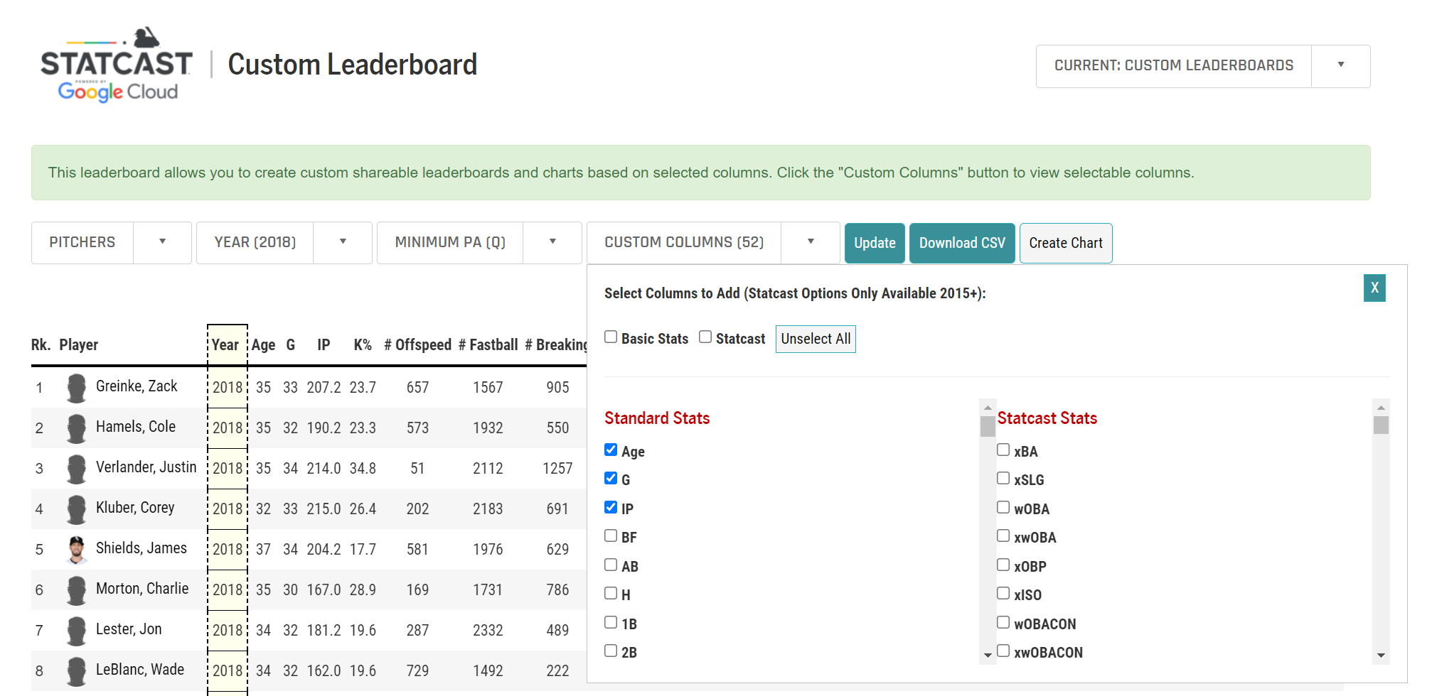
Data/ETL
Ton of publicy available data
Feature selection was the Main task
Downloaded csv files
Formatted using Pandas
Data source: https://baseballsavant.mlb.com/#
Notes:
Greg
Discuss searching for data sources and how it was mostly pro data
Found the baseball savant website that allowed us to have all of the data in csv files and it was mostly the exercise of selecting features that made sense
Manipulated in pandas by dropping any nulls

Slide 5
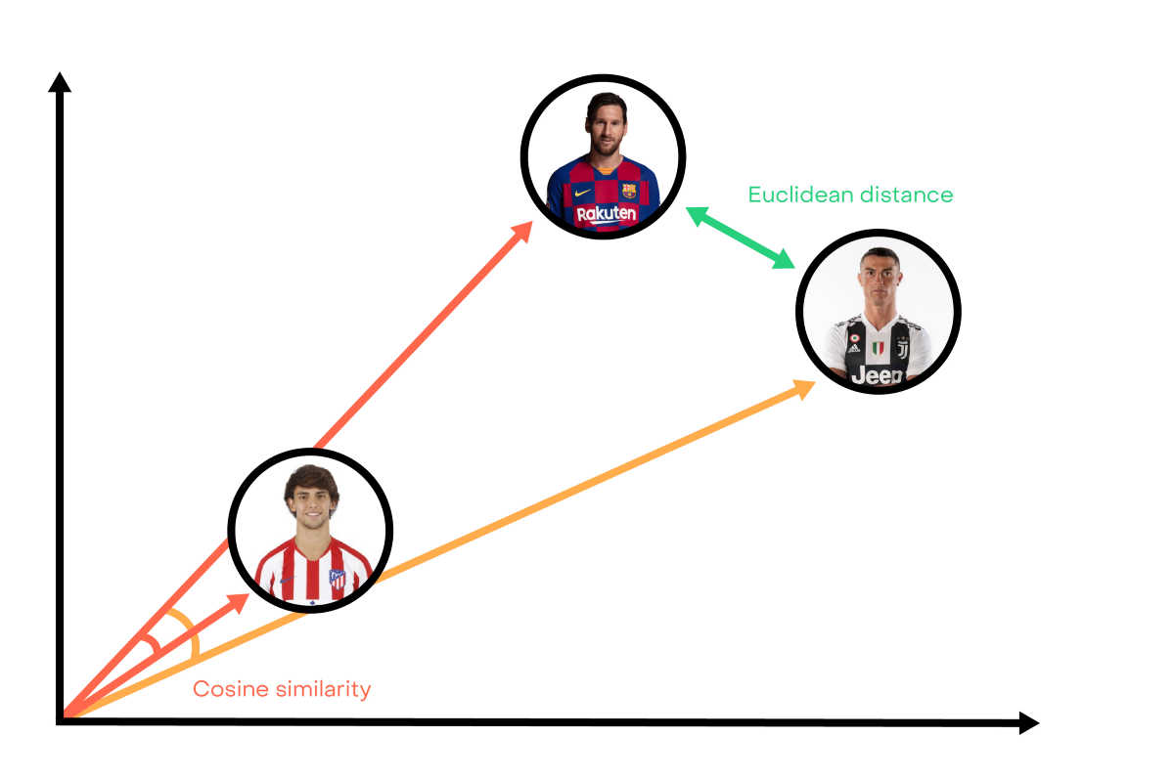
Model fitting - most similar player model
How could we predict prospect performance in the MLB?
Cosine Similarities model to approximate the prospect’s MLB equivalent
Used the match to backfill data for Outs and ERA prediction model
Notes:
Greg
Talk about how we wanted to predict prospects the same way we did pros (and eventually did), but realized that we wouldn’t be able to use the same features. Then you and Shaun found the cosine similarities and >>>
In order to match collegiate pitchers to the major league pitcher they most closely resemble in performance, we used a cosine similarity for vector space model. The sklearn.metrics.pairwise cosine_similarities model allows us to compare pairwise distance/similarity as a normalized dot product of X and Y values of the two input 2D arrays, sample and comparisons. The result of the comparison is an array with weighted values describing how similar the input vectors are to each of the vectors in the sample.

Slide 6
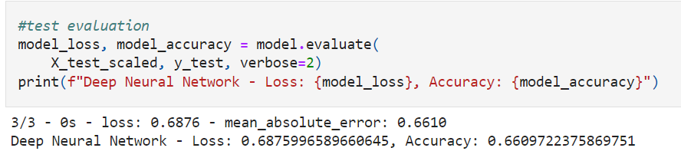
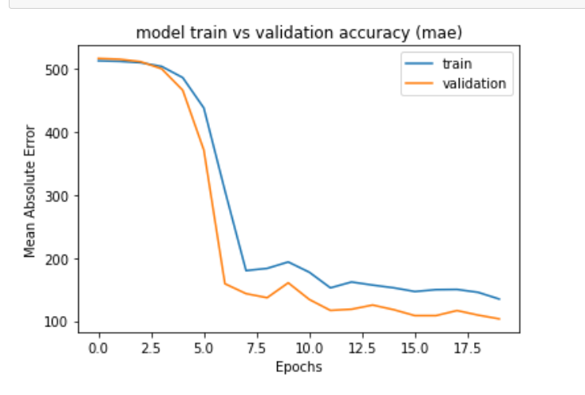
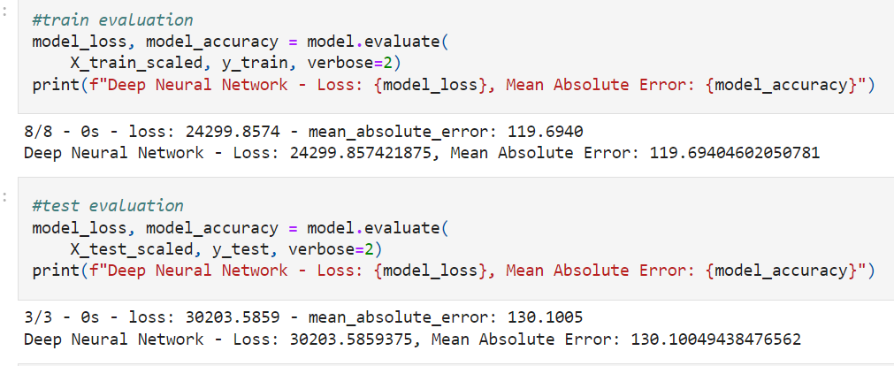
Model Fitting - ERA and Outs Deep Learning Model
Deep Learning model - regression
“Levers” = epochs, units, # layers, dropout rate
Validation split
Collinearity
Dropout layer
Removing features
ERA Model
Outs Model
Notes:
Schaefer
More trouble than I expected this to be. We started with a regular linear regression and that failed pretty quickly. We discussed with Shaun and he thought a neural network would be our best bet
From class and observing my own trial and error - my levers to fit my model and reduce error were epochs, units, # layers, and dropout rate (more on that later)
Validation split - was having difficulty trying to pin down my most sensitive lever / how I could have structure. Kristen recommended a validation split
Validation split = let keras do your train test split effectively. You set a rate and keras sets that aside as its own testing split WHILE fitting the model. Allowing me to see where the “break point” of learning is.
Collinearity - I had my validation split and I was really trying to “break it.” Like I set it to 3000 epochs just so it would be clear where the model “stopped learning.” My fitting results were a mixed bag and Shaun and I realized that I had a fundamental problem in my selected features.
Collinearity - correlation between predictor variables (or independent variables), such that they express a linear relationship in a regression model. When predictor variables in the same regression model are correlated, they cannot independently predict the value of the dependent variable.
E.g. time data like innings pitched would naturally lead to more outs, or cases where the predicted feature may be part of another stat like predicting ERA where innings pitched is in the denominator of the function
Dropout Layer - another lever that I could use to reduce error
Simply put, dropout refers to ignoring units (i.e. neurons) during the training phase of certain set of neurons which is chosen at random. By “ignoring”, I mean these units are not considered during a particular forward or backward pass.
Why did you need a drop out
A fully connected layer occupies most of the parameters, and hence, neurons develop co-dependency amongst each other during training which curbs the individual power of each neuron leading to over-fitting of training data.
Removing features - last step, there were some features that logically didn’t work.

Slide 7
Deployment/Hosting
Walk through hosting process
Notes:
Junaid
Discuss the deployment process

Slide 8


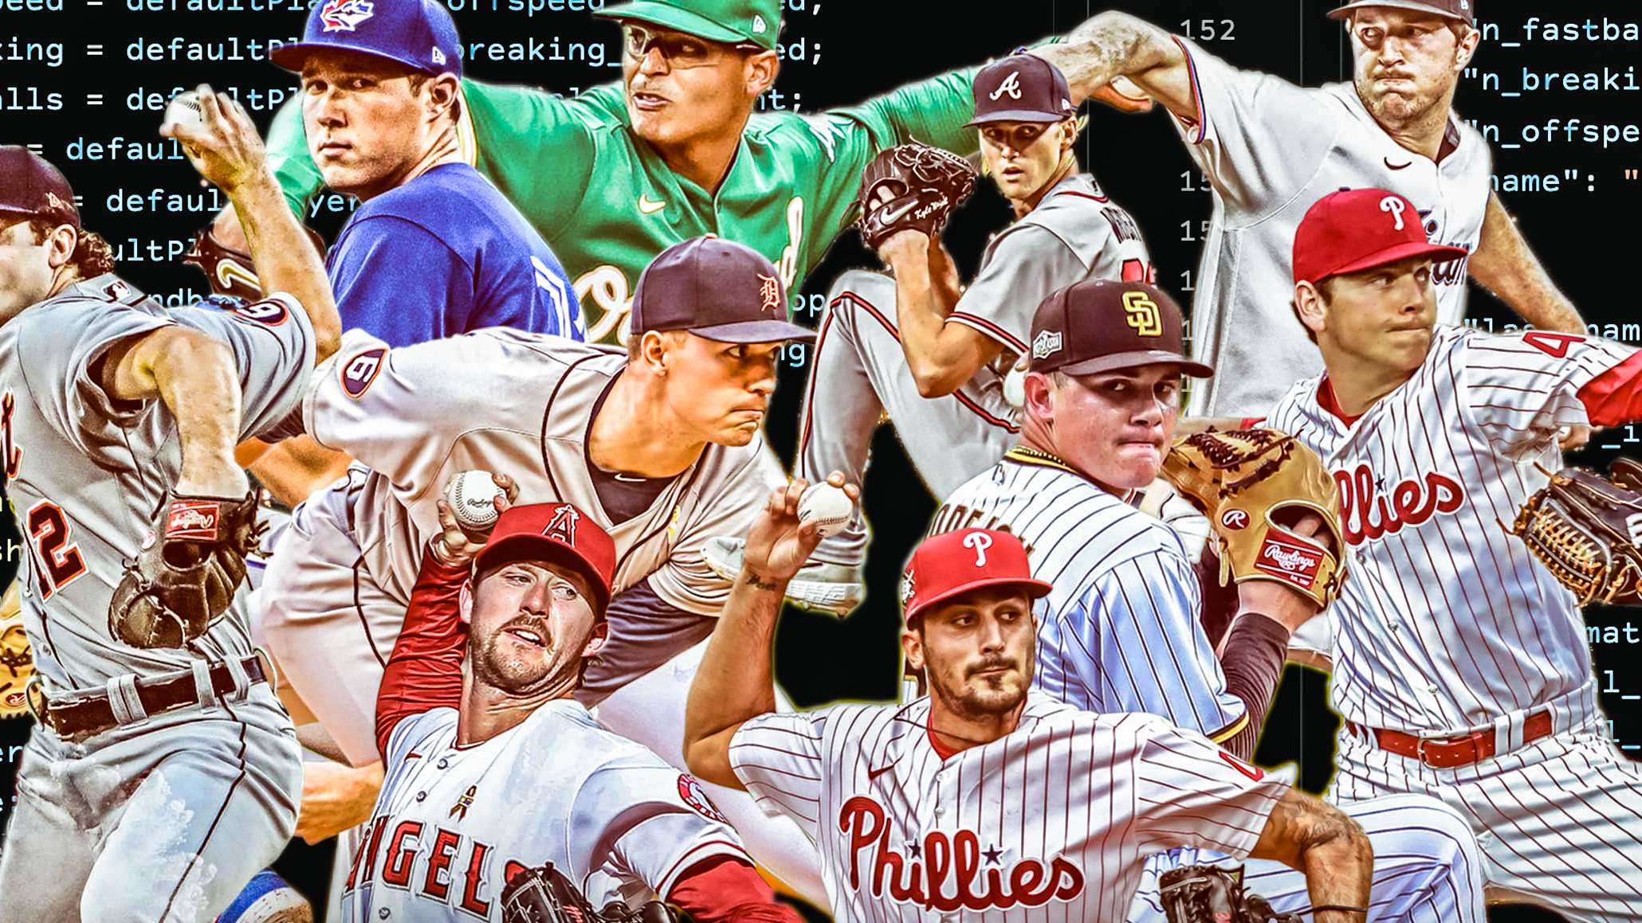
Live demo
Notes:
Mike

Slide 9
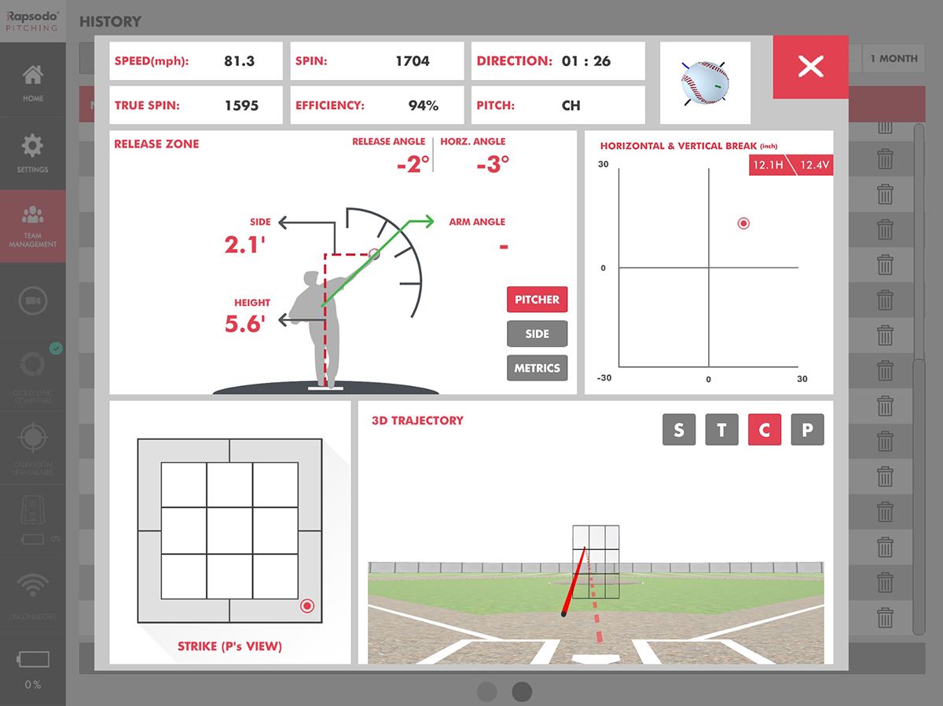
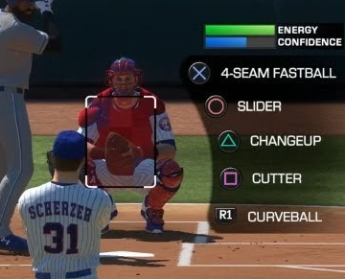
Conclusion
Data limitations for prospects
Time limitations for model fitting
Possible future project – focus in on pitch selection and specific pitching metrics (break, spin rates) to learn what translates most to outs
Notes:
Mike
Takeaways, limitations, possible next iterations

